Slide 1
C-Project Presentation
on
Event Management System
TRIBHUVAN UNIVERSITY
INSTITUTE OF ENGINEERING,THAPATHALI
Department of Electronics and Computer Engineering
Presented by:
Mandip Chhetri (THA081BEI018)
Kiran Paudel (THA081BEI013)
Purushottam Neupane (THA081BEI033)
Supervisor: Prajwol Pakka
Mar 16, 2025

Slide 2
Problem Statement
Guess what’s happening tomorrow-any ideas?
Have you heard about the latest teach fest coming up ?

Slide 3
Problem Statement
Don’t you think it would be beneficial for students if there was a system to track and notify us about upcoming events?

Slide 4
Idea 💡
Introducing our solution:
An Event Management System!

Slide 5
Focus
Objectives
Can be beneficial for Students like us.
Centralized Event Information.
Minimize the paperwork and manual recording.
Easy Event Registration process for both organizers and Participants.
Language Used
C programming

Slide 6
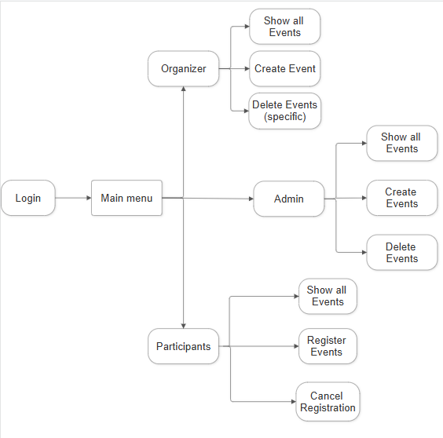
Block Diagram

Slide 7
Overview Structure
Modules
Login Module
Admin Module
Organizer Module
Participant Module

Slide 8

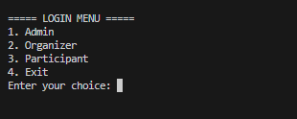
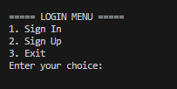
Login Menu
For admin (Default)
For Organizer and Participant

Slide 9
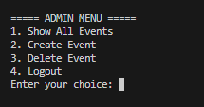
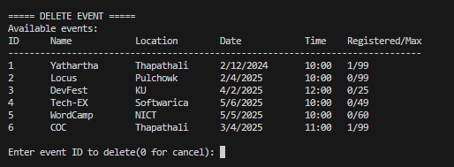
Admin Section
Admin has all the access of all Events and have access to delete any event created by any Organizer

Slide 10
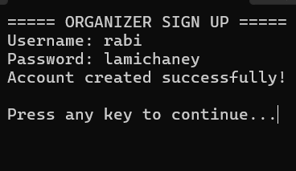
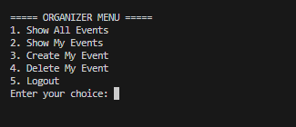
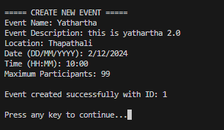
Organizer Section
Organizer can create the events and able to Delete their own events

Slide 11
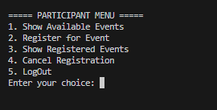
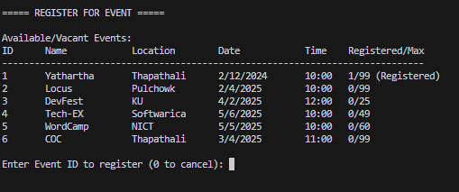
Participation Section
Participant can Register for an Event with respective Event IDs and also cancel Registration

Slide 12
Tools and Resources used
IDE
Visual studio code
Version Control
Git
Github

Slide 13
Tools and Resources used
Programming Language
C
Header Files
stdio,h
conio.h
stdlib.h
string.h

Slide 14
Future Improvement
Expand the system to a web-based and mobile platform.
Replace file handling with a relational database like MySQL.
Automated Notifications.
Payment Gateway Integration.
AI-Based Event Recommendations (Events Suggestion).
Provide detailed reports, statistics, and graphical analysis of event participation and trends.
User Role Expansion by Introducing additional roles such as event sponsors, vendors,etc.

Slide 15
Conclusion
Hands-on Learning – Applied C programming to solve a real-world problem.
Team Collaboration – Strengthened problem-solving and teamwork skills.
Challenges & Growth – Overcame technical hurdles, improving creativity and persistence.
Project Documentation – Successfully prepared a proposal and report.
Future Scope – Inspired to explore databases, web development, and AI for enhancements.

Slide 16
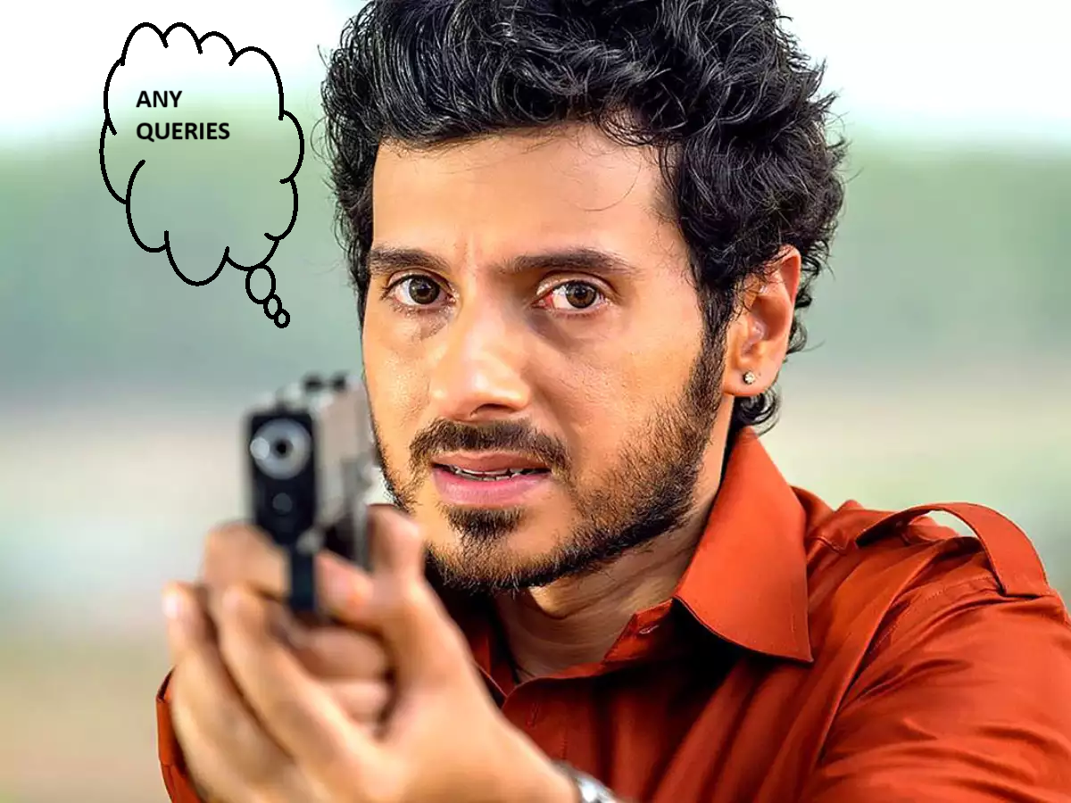
Queries?

Slide 17
Queries?
THANK YOU!

